Slide 1
Code Camps
This is our second to last lesson for this term!
We will be finishing our games today and adding a few features.
We will need to split you into two groups.

Slide 2


Group A
Group B

Slide 3
Group A
Harry and Group A will be working on adding new features to our game today such as coins and a score.
* You are in this group if you coded last lesson.

Slide 4
Group B
Emily and Group B finish your game, such as introducing player movement, she will go over the instructions with you.
Once you have finished, you can play games on learningtocode.co.uk until Group A have finished.
* You are in this group if you did not code last lesson / wasn’t here.

Slide 5
Group A

Slide 6
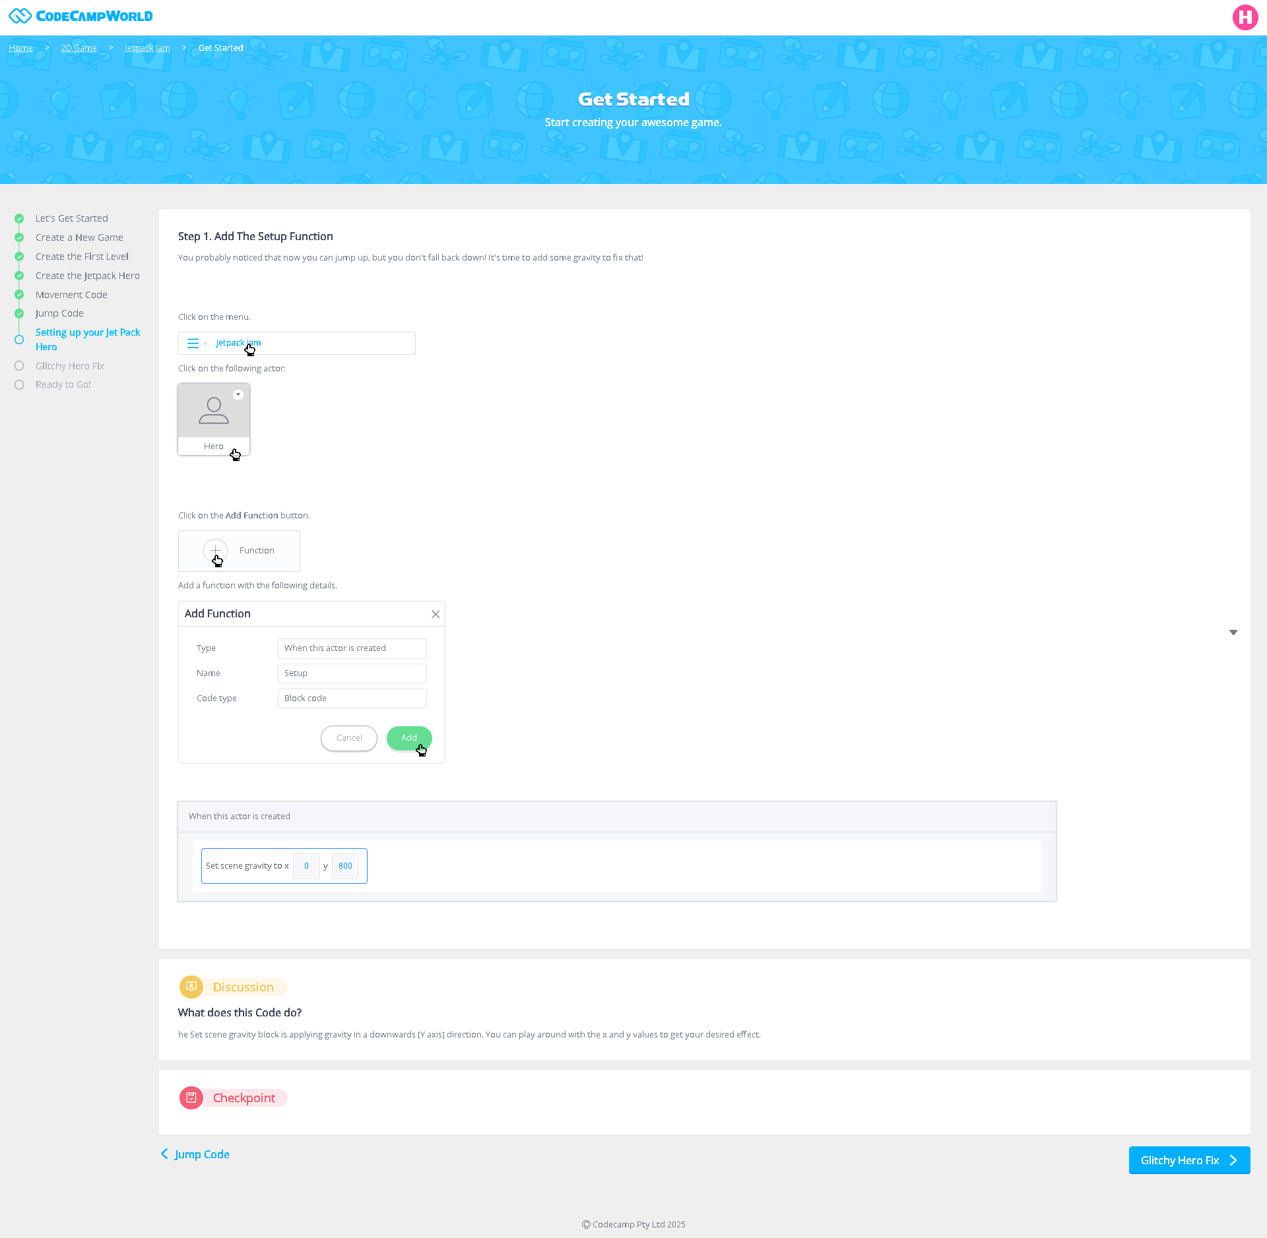

Slide 7
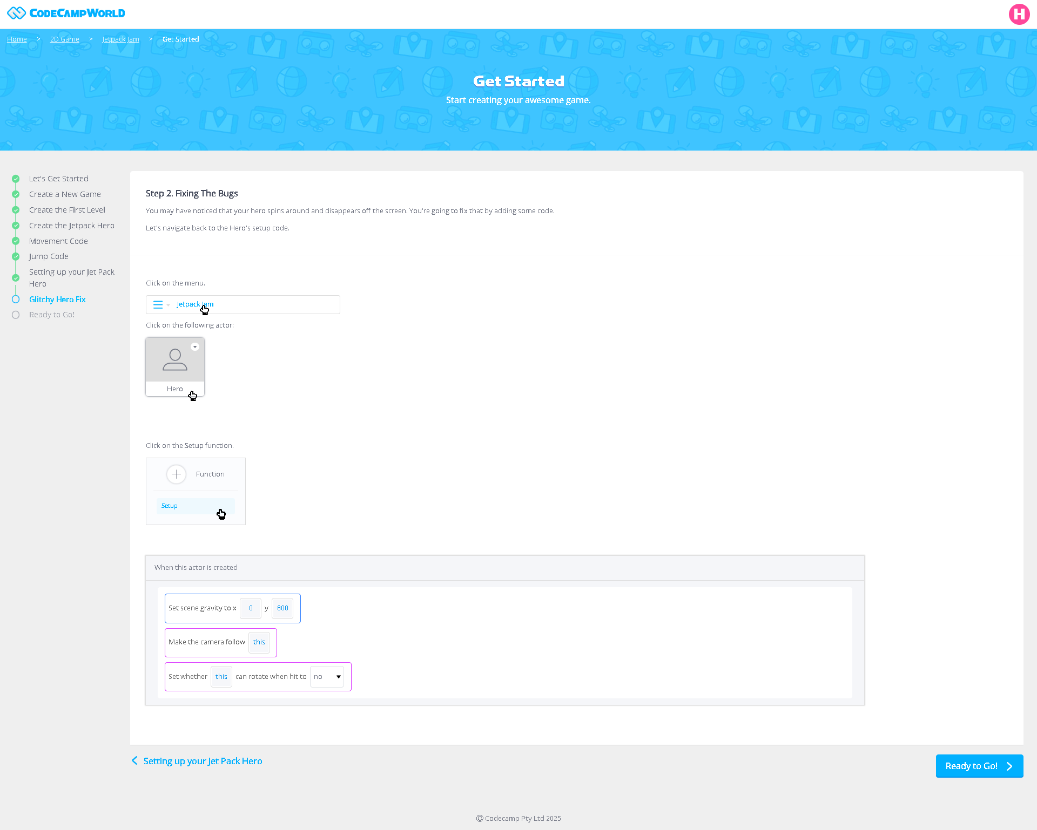

Slide 8
Group B

Slide 9
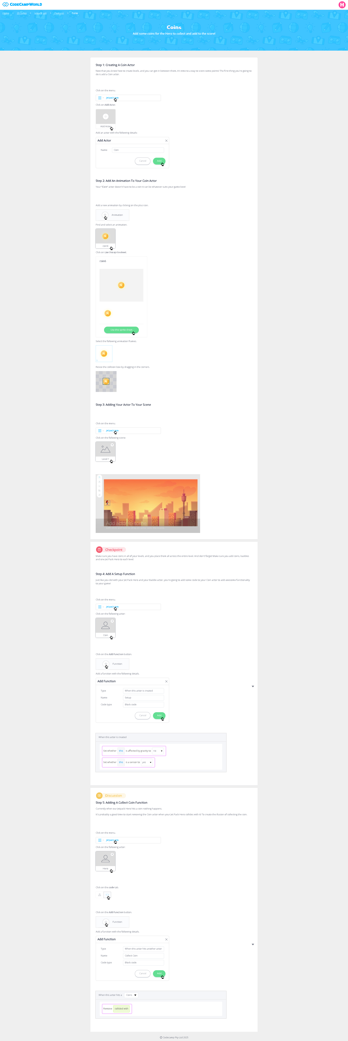

Slide 10
